Slide 1
Improving Shared Decision Making Between Clinicians and LGBTQ Racial/Ethnic Minority Patients
Scott Cook, Marshall Chin, Susanna Howard, Aviva Nathan and Lucy Xu
University of Chicago

Slide 2
Disclosures / Funding
Agency for Healthcare Research and Quality
U18 HS023050
Robert Wood Johnson Foundation
Finding Answers: Solving Disparities Through Payment and Delivery System Reform
Notes:
Robert Wood Johnson Foundation

Slide 3
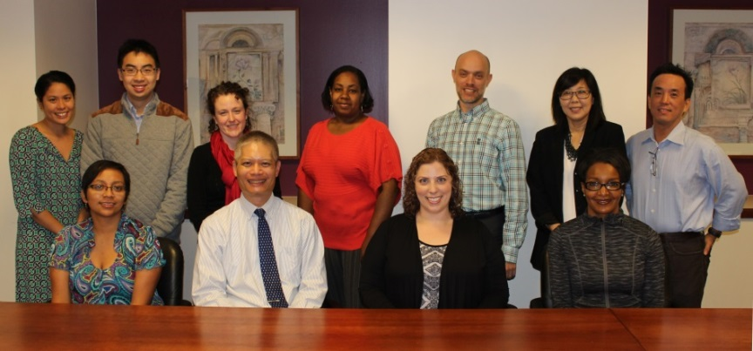
Team Members/ Presenters
Indiana University
Alexia Torke, MD
University of California, San Francisco
Judy Tan, PhD
University of Chicago
Mary Ellen Acree, MD
Arshiya Baig, MD, MPH
Marshall Chin, MD, MPH
Scott Cook, PhD
Elbert Huang, MD, MPH
Karen Kim, MD
Moira McNulty, MD
Monica Peek, MD, MPH
Mai Pho, MD, MPH
John Schneider, MD, MPH
Seeba Anam, MD
Neda Laiteerapong, MD, MS
Monica Vela, MD
Michael Quinn, PhD
Rachel DeMeester, MPH
Kathryn Gunter, MPH
Fanny Lopez, MPP
Aviva Nathan, MPH
Yolanda O’Neal, MPH
Olivia Blocker
Justin Jia
Susanna Howard
Lucy Xu
The Chicago School of Professional Psychology
Braden Berkey, Psy.D
Goddard College
H. Sharif Williams, PhD
New York University
Simona Kwon, DrPH, MPH
Morten Group
Mary Morten
Lisa Gilmore
Vince Pagan
Notes:
Note the handout with project Co-Pis and consultants

Slide 4
Acknowledgments
Harvey Makadon, MD
National LGBT Health Education Center
www.lgbthealtheducation.org
Department of Diversity, Inclusion and Equity
The University of Chicago Medicine
John Schneider, MD
The University of Chicago
Notes:
Much of the information in this presentation was originally presented in other LGBT cultural competency trainings by Harvey Makadon from the national LGBT Health Education Center
and trainings that I have done with John Schneider at the University of Chicago.
It has been modified for this presentation and our own material has been added. We are grateful to Harvey, John and the National LGBT Health Education Center.

Slide 5
Agenda
Boundaries – Safe Space
Shared Decision Making and Intersectionality
Ethical Practice and Culturally Competent Care
Case Vignettes – Role Play
Report Back
Evaluation

Slide 6
Limitations
We do not have all the answers
Many voices – our workshop is a start
All of us will need more practice engaging racial/ethnic minority LGBTQ patients in shared decision making – this workshop is just a start

Slide 7
Safe Space
Respect
Openness
Participate
Escuchar (To Listen)
Safety

Slide 8
Shared Decision Making and Intersectionality
Notes:
Completely Verbal presentation (with Fenway handout)
See external notes

Slide 9
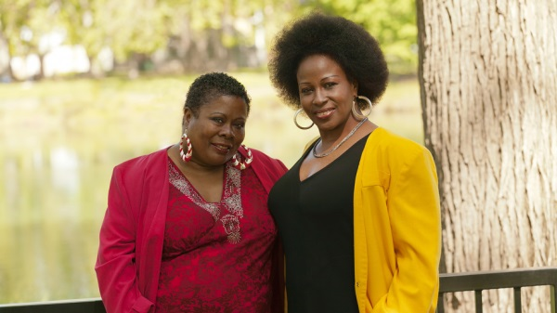
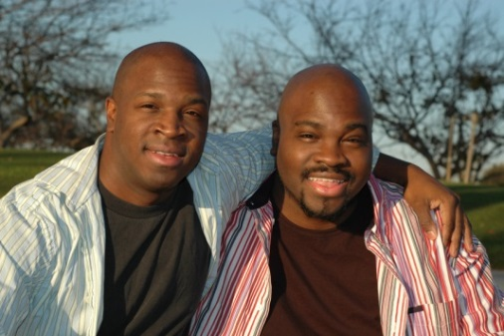
Shared Decision-Making and Intersectionality:
Race/Ethnicity + LGBT
Monica E. Peek, MD, MPH, MSc
University of Chicago

Slide 10
Shared Decision-Making: The “3 Ds”
DISCUSS DEBATE DECIDE
Information Sharing
Deliberation
.
Decision Making/ Implementation
Notes:
From the Diversity and Inclusion Department at University of Chicago
The need for self-assessment---handouts.

Slide 11
Shared Decision-Making Domains
Information-Sharing
Bi-directional exchange of information
Symptoms, diagnoses, lifestyle issues
Deliberation/Physician Recommendations
Full disclosure of treatment options
Patient preferences elicited/discussed
Decision-making/Implementation
Patients and physicians arrive at a treatment plan
Notes:
From the Diversity and Inclusion Department at University of Chicago
The need for self-assessment---handouts.

Slide 12
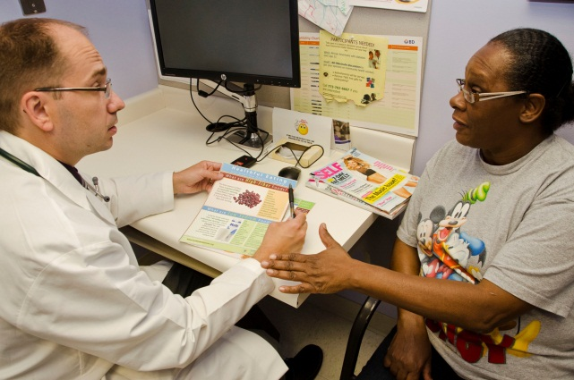
Shared Decision-Making BARRIERS
Power imbalance
Limited health literacy
Self-efficacy
Trust
Fear/denial
Normative beliefs
Notes:
From the Diversity and Inclusion Department at University of Chicago
The need for self-assessment---handouts.

Slide 13
Shared Decision-Making Facilitators
Patient engagement/invitation
Interpersonal relationships
Validating health concerns
Accessibility/availability
Notes:
From the Diversity and Inclusion Department at University of Chicago
The need for self-assessment---handouts.

Slide 14
Shared Decision Making Process
Patient/Provider Relationship
Trust
Trust
Decision-making Preferences
Shared Decision-Making
Information Sharing
Deliberation
Decision-Making
Decision-making Preferences
0
0
0
0
Trust
Satisfaction
Provider
Patient
Self-efficacy
Understanding
Job Satisfaction,
Cultural Competence, Patient-Centered Care
Self-Management, Treatment Adherence
Health Outcomes
Clinic
Community
Society

Slide 16
Intersectionality
“…she knew that top surgery was also different for White people versus People of Color. She actually went and had examples and photos…about how scars might look different or how healing might look different. Never in a healthcare experience have I ever had a doctor, a White doctor especially, who is aware of how something might be different for me and actually give me advice about it.”
“Tell me a story about a time when you had a good healthcare experience.”

Slide 17
Intersectionality
“In general it’s just a lot of making compromises…and I do tend to wait however when seeking out care…because I don’t know how to look. Or even if I’m calling places to get information, I don’t know how to ask questions to get the information that I need to make that decision.”
“How does being both a person of color and a transgender person affect how you choose a health care location that feels comfortable to you?”

Slide 18
Intersectionality
“My partner is White. Providers tend to interact with me differently when I’m with her. …the sort of confusion that my presence sometimes seem to inspire. I think it’s just how helpful, how warm providers are changes whether I’m accompanied by a White person or not.”
“How does being both a transgender person and a person of color affect how your providers interact with you?”

Slide 19
Intersectionality
“Definitely…if I know the provider is queer/LGBT, I’m far more likely to disclose, especially now that people tend to read me like a dude. And race definitely plays a part and it’s complicated. There are a lot of internalized feeling about what our brown communities do or don’t accept…based on internalized racism that I recognize….it does make me less likely to disclose because…it’s so rare to have a provider that’s a person of color that I fear alienating that person. So it feels easier just to pass…and wait to see how safe it is before disclosing the other identity.”
“Does disclosing your gender identity vary based on the race, ethnicity or LGBTQ status of the clinician?”

Slide 20
Intersectionality
“In what ways do stereotypes about transgender people of color influence how your provider communicates with you or how they treat you?”
“I don’t think that they do in the sense that I don’t think people really recognize that Asian Trans Men exist.”

Slide 21
Ethical Practice and Culturally Competent Care
Agency for Healthcare Research and Quality

Slide 22
Ethical Practice
Recognition of one’s biases and community dynamics, a sensitivity to cultural differences, the avoidance of generalizations about cultures, the provision of culturally competent care and challenging racism, heterosexism, genderism, and sexism among colleagues, the institution, or in the community at large.
Notes:
Much of the information in this presentation was originally presented in other LGBT cultural competency trainings by Harvey Makadon from the national LGBT Health Education Center
and trainings that I have done with John Schneider at the University of Chicago.
It has been modified for this presentation and our own material has been added. We are grateful to Harvey, John and the National LGBT Health Education Center.

Slide 23
Culturally Competent Care
Learn to recognize and reject our preexisting beliefs about a particular culture
Focus on understanding information provided by individuals within the context at hand
Resist the temptation to classify or label; avoid fixed and generalized information
Notes:
Much of the information in this presentation was originally presented in other LGBT cultural competency trainings by Harvey Makadon from the national LGBT Health Education Center
and trainings that I have done with John Schneider at the University of Chicago.
It has been modified for this presentation and our own material has been added. We are grateful to Harvey, John and the National LGBT Health Education Center.

Slide 24
Barriers to Cultural Competence
Fear of being labeled racist, sexist, homophobic, etc.
Our own positive or negative stereotypes about members of other groups
Expectation that we must be certain about issues of diversity and cultural competence
Notes:
Much of the information in this presentation was originally presented in other LGBT cultural competency trainings by Harvey Makadon from the national LGBT Health Education Center
and trainings that I have done with John Schneider at the University of Chicago.
It has been modified for this presentation and our own material has been added. We are grateful to Harvey, John and the National LGBT Health Education Center.

Slide 25
Barriers to Cultural Competence
Lack of awareness of hot buttons to which we are the most vulnerable
Not knowing how to respond to angry comments or anger directed at us
Being overwhelmed by our strong emotions caused by a situation
Lack of skills for cross-cultural communication
Notes:
Much of the information in this presentation was originally presented in other LGBT cultural competency trainings by Harvey Makadon from the national LGBT Health Education Center
and trainings that I have done with John Schneider at the University of Chicago.
It has been modified for this presentation and our own material has been added. We are grateful to Harvey, John and the National LGBT Health Education Center.

Slide 26
Case Vignettes – Role Play
Agency for Healthcare Research and Quality

Slide 27
Case Vignettes / Role Play
Small Breakout Groups
60 minutes – 2 Role Plays
Roles
Facilitator
Patient
Provider
Observer
Note taker/large group debriefing representative
Role Information Provided
Sexual orientation / Gender identity
Racial / ethnic minority self-identification
Some medical and social history
Purpose of the healthcare visit
SDM continuum
Discuss, Debate, Decide
Notes:
Much of the information in this presentation was originally presented in other LGBT cultural competency trainings by Harvey Makadon from the national LGBT Health Education Center
and trainings that I have done with John Schneider at the University of Chicago.
It has been modified for this presentation and our own material has been added. We are grateful to Harvey, John and the National LGBT Health Education Center.

Slide 28
Safe Space Reminder
Respect
Openness
Participate
Escuchar (To Listen)
Safety

Slide 29
Report Back
Agency for Healthcare Research and Quality

Slide 30
Additional Resources
Agency for Healthcare Research and Quality
Notes:
Direct participants to the resource handout

Slide 31
Evaluation
Agency for Healthcare Research and Quality

